Slide 1
Wearable Device Health Management System
Name: Dongyue Li
NUID:001632075

Slide 2
Part 1: Background
Nowadays, wearable devices provide a great deal of change and great convenience to our lives. The emergence of smart wearable devices brings Internet of Things-extending from internet into the user's daily life.
Wearable device is not just a hardware device, it is supported by the software, data exchange, and cloud interaction to achieve powerful functions.
A variety of smart wearable devices are sensors, transferring the body functions of users and exercise data to the cloud via smartphones, then analysis and application. The work principle is the use of sensors, radio frequency identification (RFID), global positioning systems and other information sensing device. It accesses to the mobile Internet according to the agreed protocol, and enables the connection and exchange of information between people and things at anytime, anywhere.

Slide 3
Part 2:Problem Statement
Due to imperfect public health management system, high medical costs, fewer channels and low coverage problems are plaguing public‘s livelihood. In particular, “the low efficiency of medical system, the poor quality of medical services, the difficult and expensive medical treatment” as the main focus of social concern.
In the past, only through the hospital or professional medical institutions for medical examination, resulting in long examination period and physical symptoms often can not be found in time, a lot of patients miss the best treatment period.

Slide 4
Part 3: Proposed Solution
This project provides a Wearable Device Health Management System which is related to patient, doctor, pharmacy, government, equipment manufacturer and so on. This system can collect the data on wearable devices, and allow users to measure their physiological information at home. By analyzing the real-time monitoring health data of wearable devices such as vital signs and fitness record, we can give more appropriate individual feedback on human health and sent the data to the patient primary doctor in time to get diagnostic advice. Especially for patients with chronic disease, it will help lot. At the same time, government departments can get more accurate health information, which is used to plan the urban health problems.

Slide 5
Part 4: Object Model

Slide 6
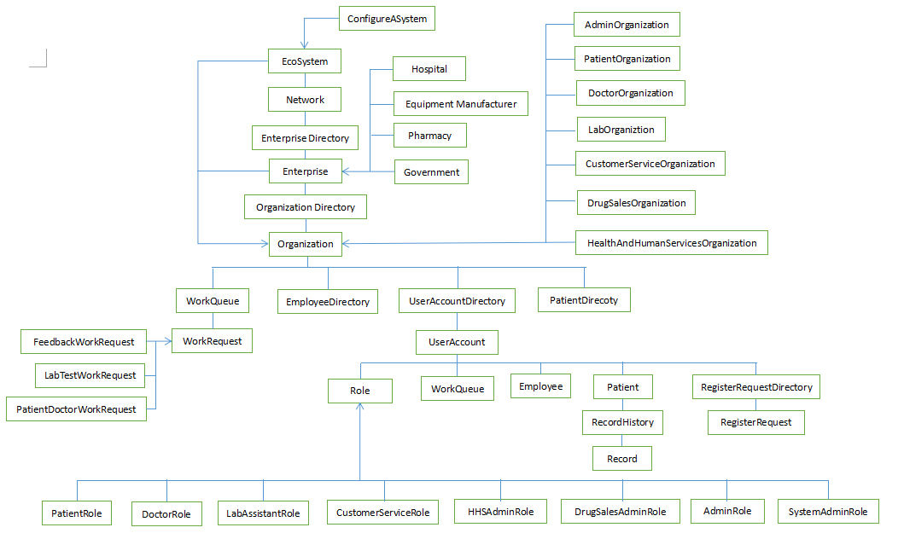

Slide 7
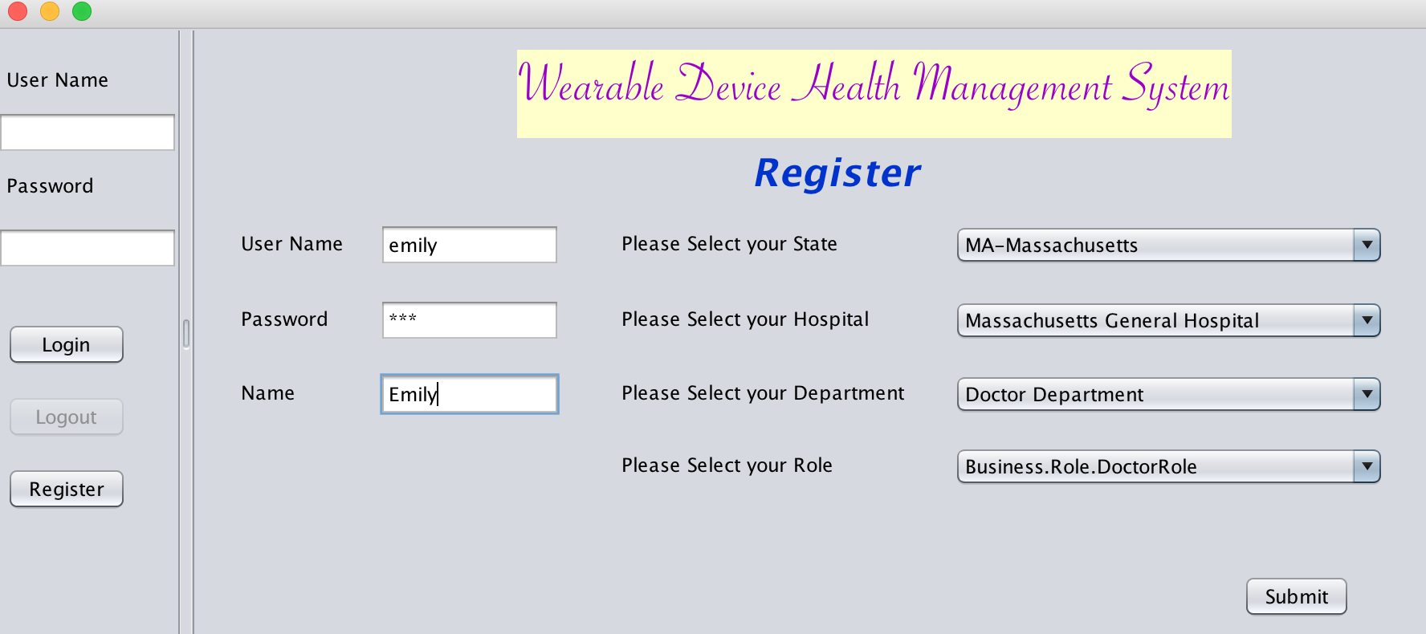
Part 5: Features -- Register

Slide 8
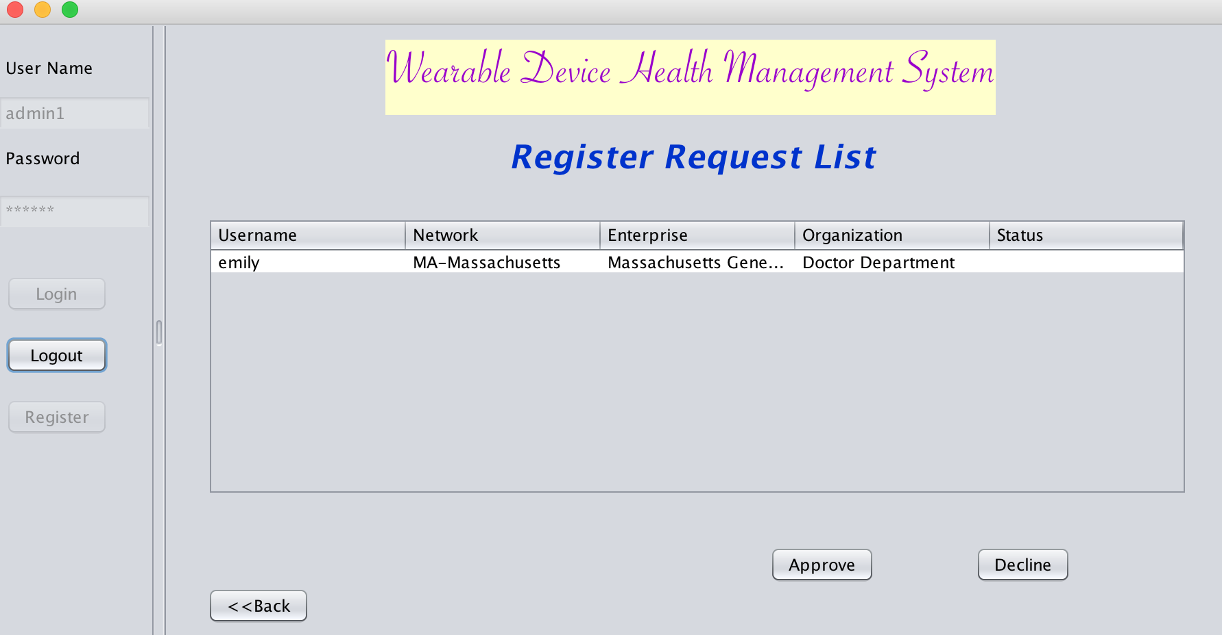
Part 5: Features -- Register

Slide 9
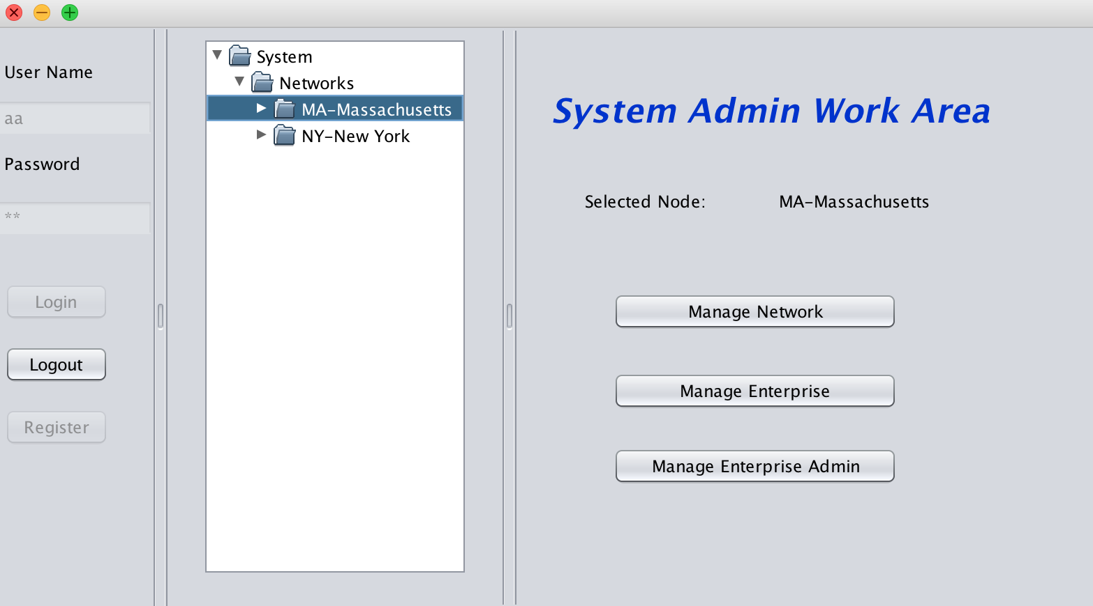
Part 5: Features -- System

Slide 10
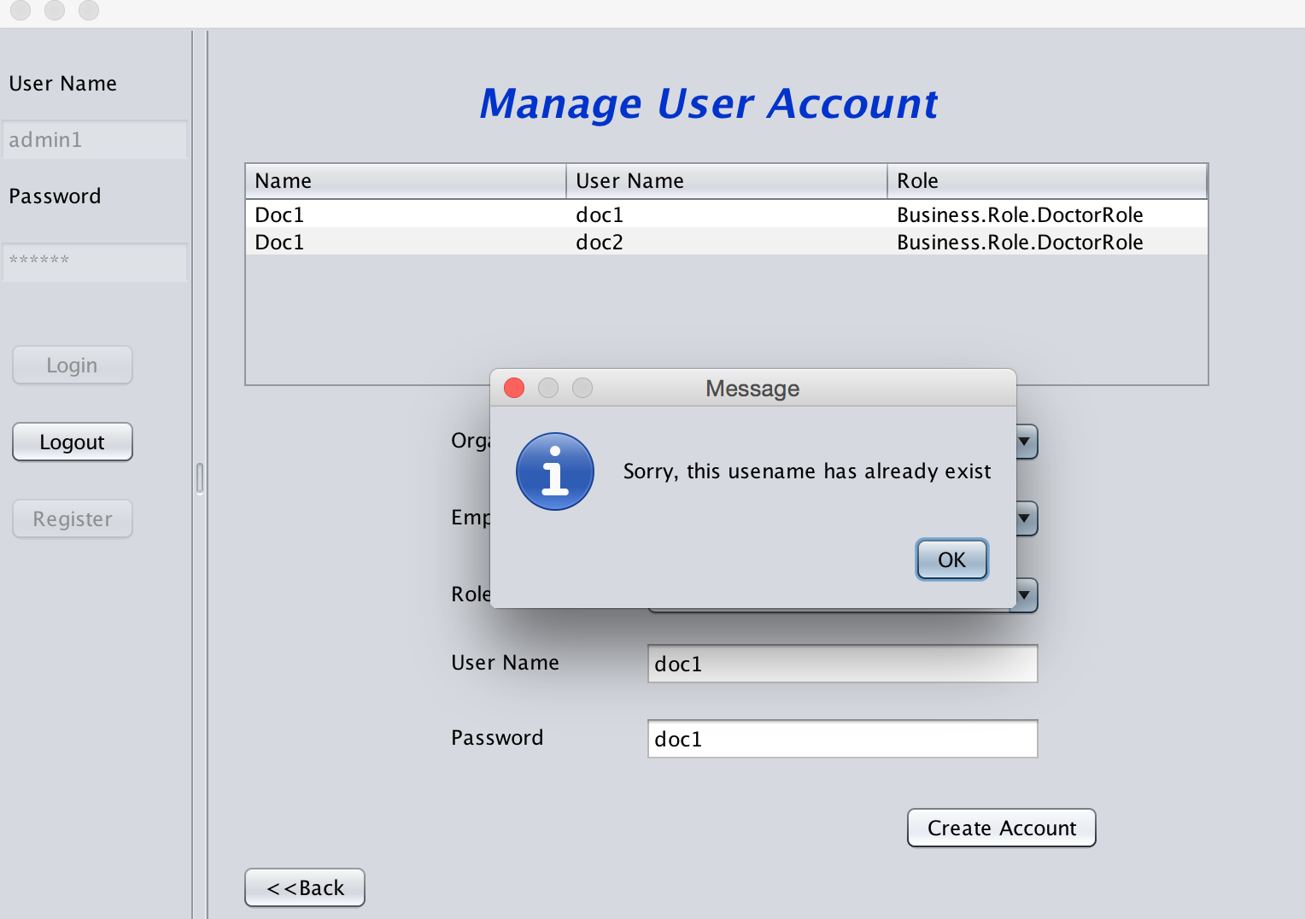
Part 5: Features – Check Username Unique

Slide 11
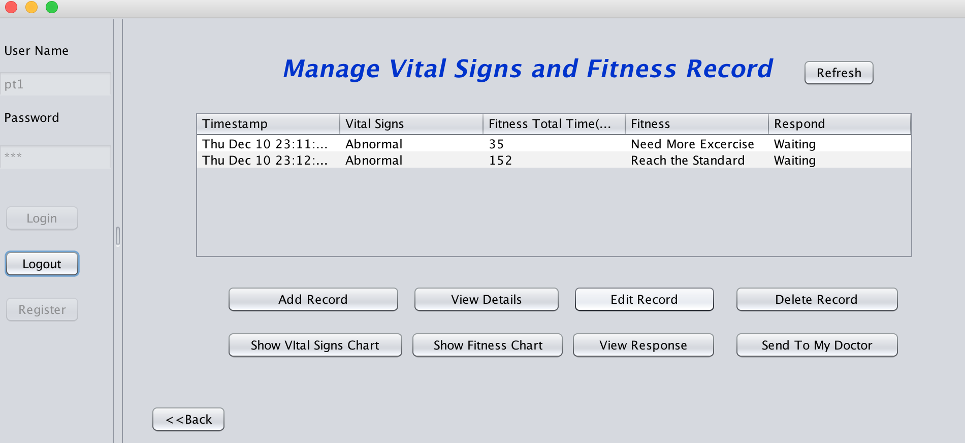
Part 5: Features--Check Record Status

Slide 12
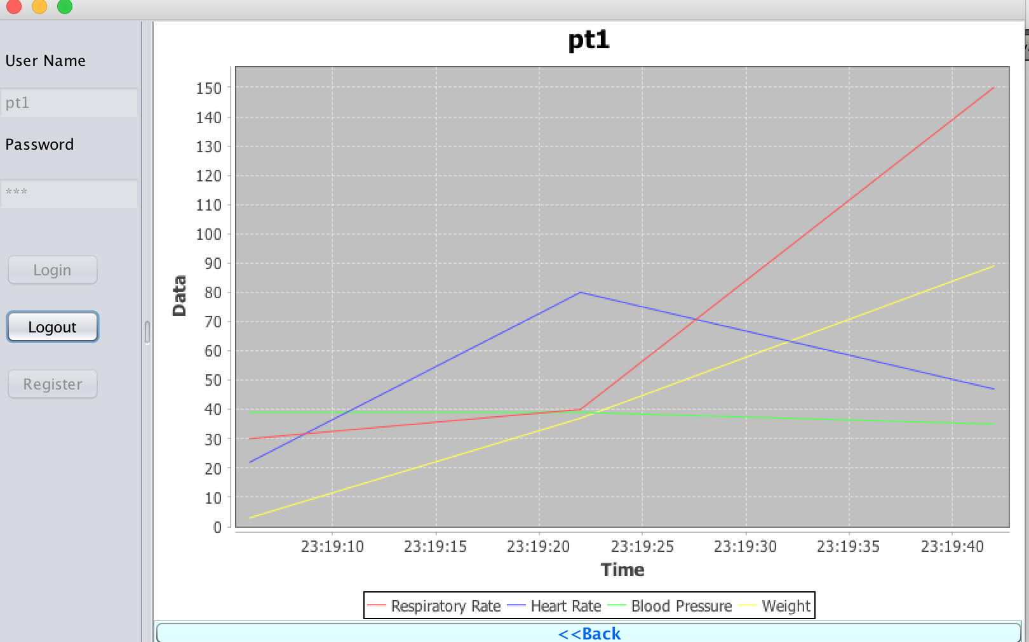
Part 5: Features – Chart

Slide 13
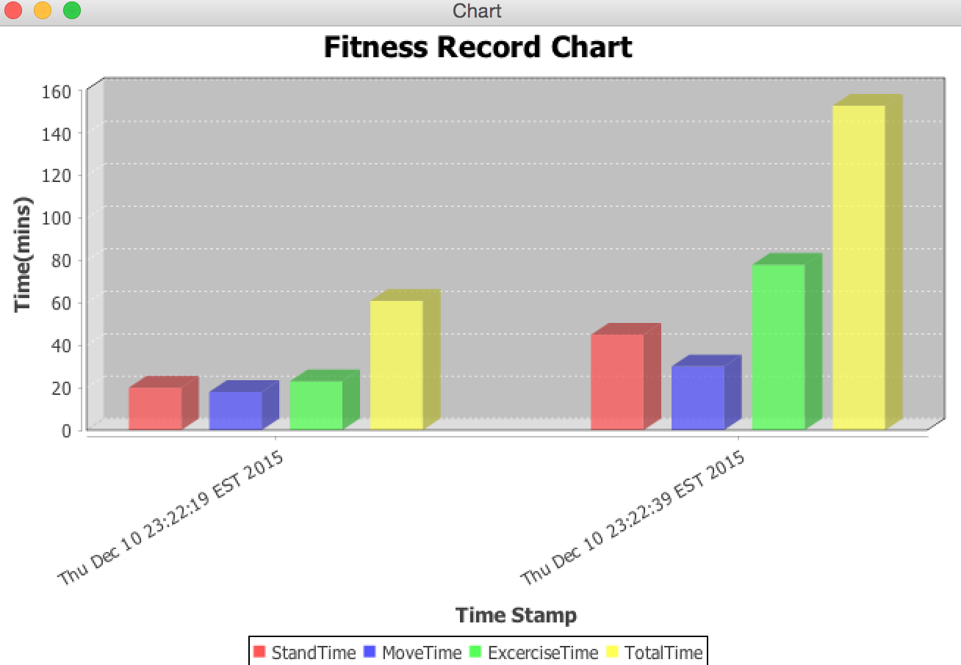
Part 5: Features – Chart

Slide 14
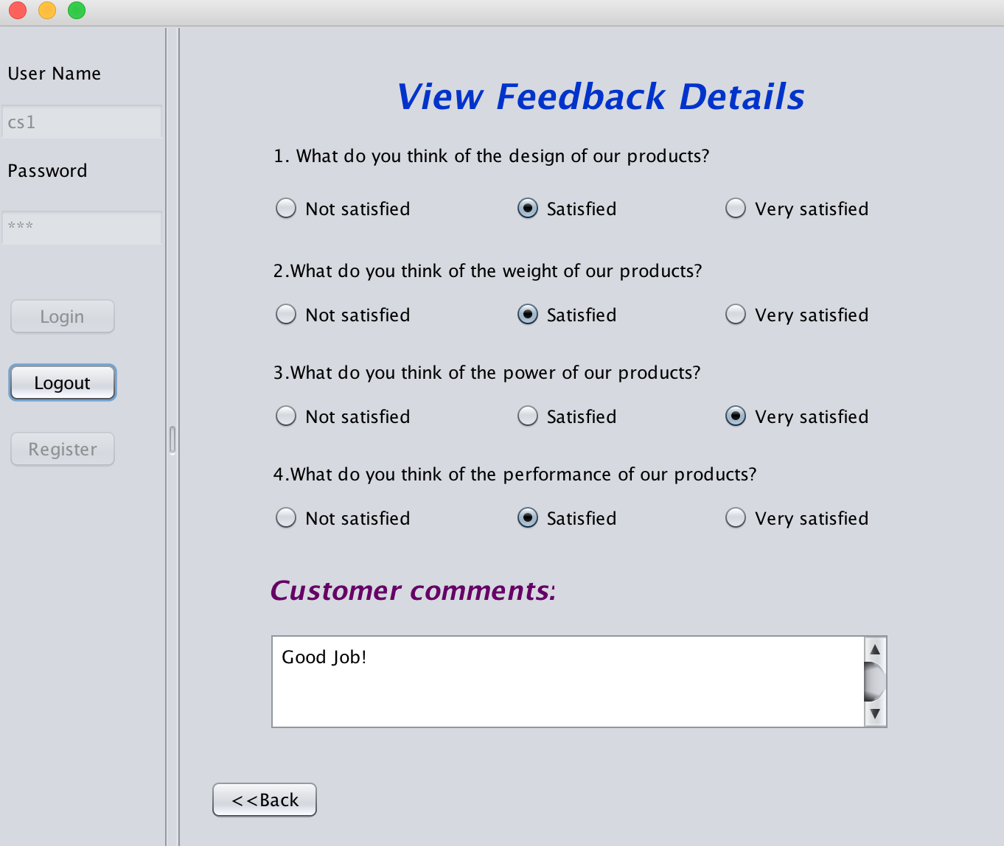
Part 5: Features –- Feedback

Slide 15
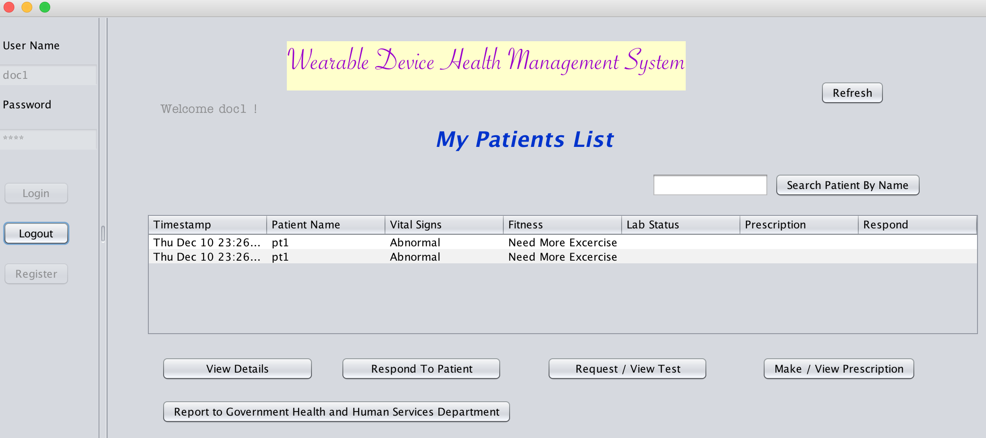
Part 5: Features – Doctor Response

Slide 16
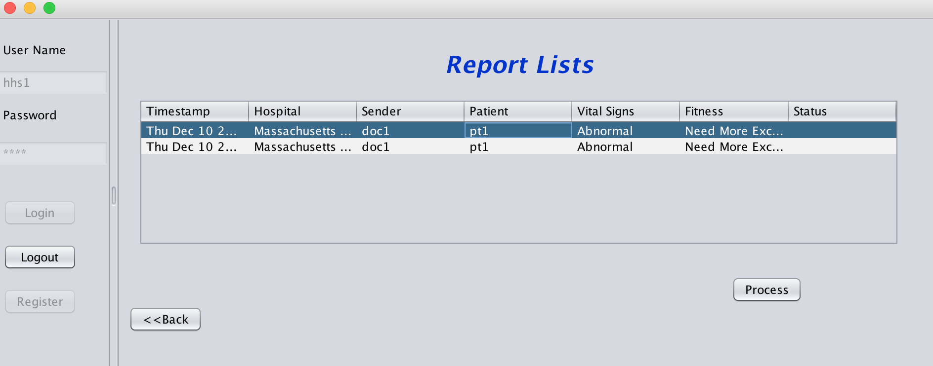
Part 5: Features -- Government

Slide 17
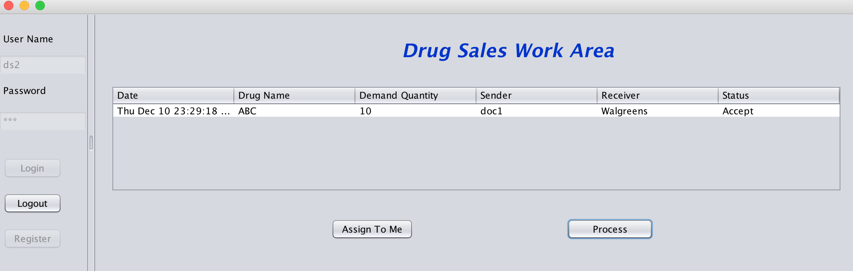
Part 5: Features -- Pharmacy

Slide 18
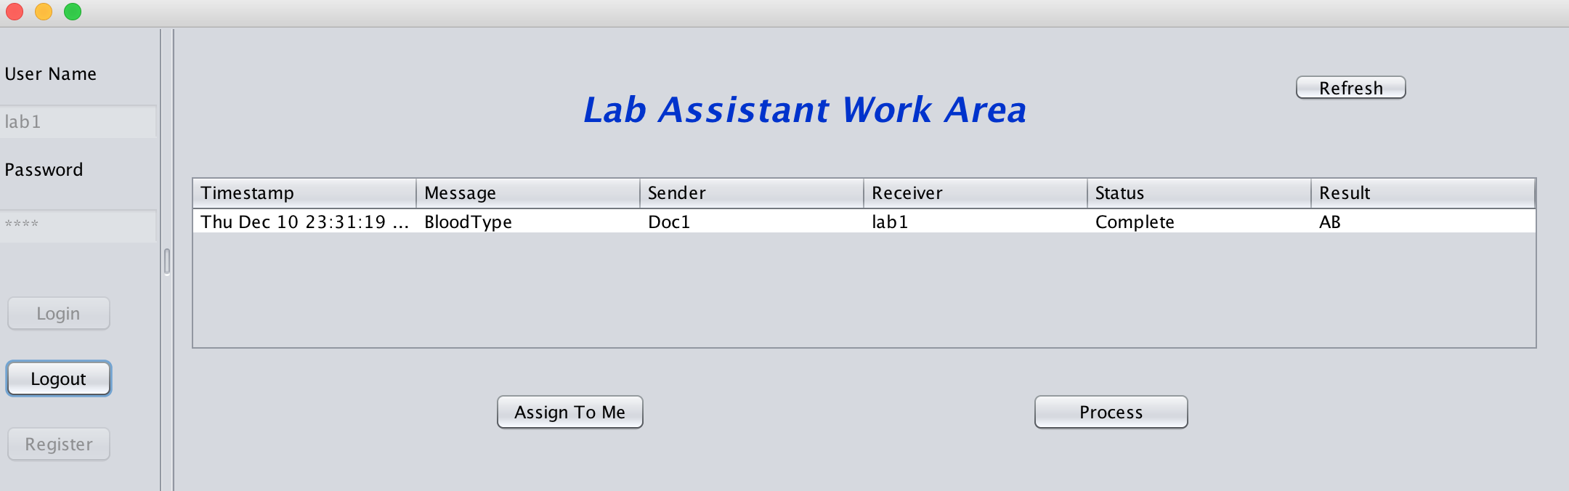
Part 5: Features -- Lab

Slide 19
Part 6: Approach
Inheritance
I organized classes using inheritance to avoid duplication and reduce redundancy. As there are many kind of roles of user using this system. I make Role class abstract and every different role will extend Role class.
Another example of using inheritance. Based on my design, this system will allow different kind people login and the data will be saved in different organization and departments. These organizations share many commosns, for example, every organization has its own name, user account directory, work queue and so on. So I created a Abstract class named Organization, subclass which represents different organization extends this class. This approach has greatly reduced my work while I do not need to create the same variable and method for each class over and over again.

Slide 20
Part 6: Approach
The "instanceof" Operator
"instanceof" operator used for check whether a class is one specific subclass or not. For example, when creating user account for different people, the user information should be save based on what kind of organization they belong to.

